Slide 1
“Libraries always remind us that there are good things in this world ”

Slide 2

LIBRARY MANAGEMENT SYSTEM
Under the guidance of Dr.B.Samatha,
Assistant professor,CSE
DONE BY:
J.Hamsini (201FA04443)
D.Akhila (201FA04448)
Ch. Naga Alekhya (201FA04457)

Slide 3
Contents
Introduction
Problem statement
Solution
Features of Project
Requirements
Interfaces and database tables
conclusion

Slide 4
Introduction
“ Library Management System ” maintains the information about the books present in the library, their authors, the members of library to whom books are issued, library staff and all.
It is very difficult to organize manually, and maintenance of all this information is also a very complex task.
So, our project would provide basic set of features to add/update members, add books, and manage check in specifications for the systems based on the client’s statement of need.

Slide 5
Problem Statement
Assigning books to students and managing them manually is difficult.
Space consuming.
Cost consuming.
Searching for information about staff or students is tough.
Updating records will not be easy.

Slide 6
Solution
Development of this library management system contains the features, which automates the entire process.
Automates information related to all books.
Provides security.
Maintaining database is easier than manual records.
Time saving,Cost efficient and saves space .

Slide 7
Features of the project
Manage books.
Manage users.
View available Books.
View available Publications.
Send Remarks.
Search Books.

Slide 8
Requirements
Software Requirements
MY SQL Workbench 8.0 CE
MY SQL connector
NetBeans IDE 8.2
Front-End: JSP, Html, CSS, JS.

Slide 9
Requirements
Server-side: Servlet. Back-end: MYSQL. Server: Tomcat 10.0.21.
Hardware Requirements
Basic requirements of a computer system.No other specific hardware is not required to run this software.

Slide 10
JDBC Connections
Import required packages
Load a JDBC Driver
Register the diver
Create a connection to the Database
Create statement for object
Execute SQL statements
Close the SQL connection

Slide 11
INTERFACES

Slide 12
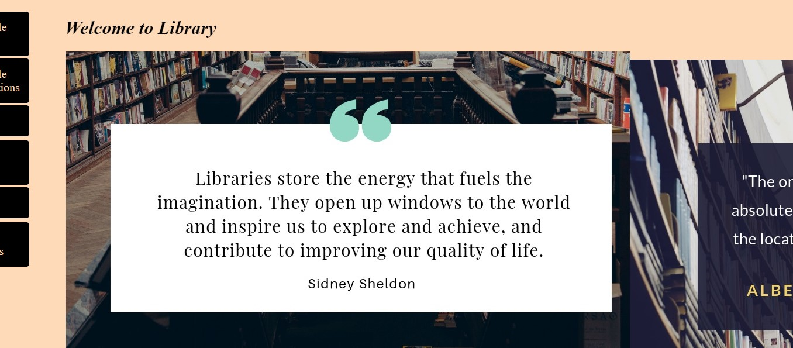
Home Page

Slide 13
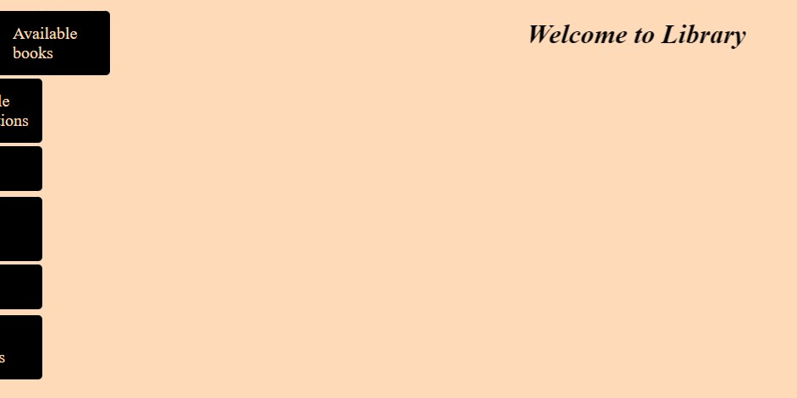

Available books

Slide 14
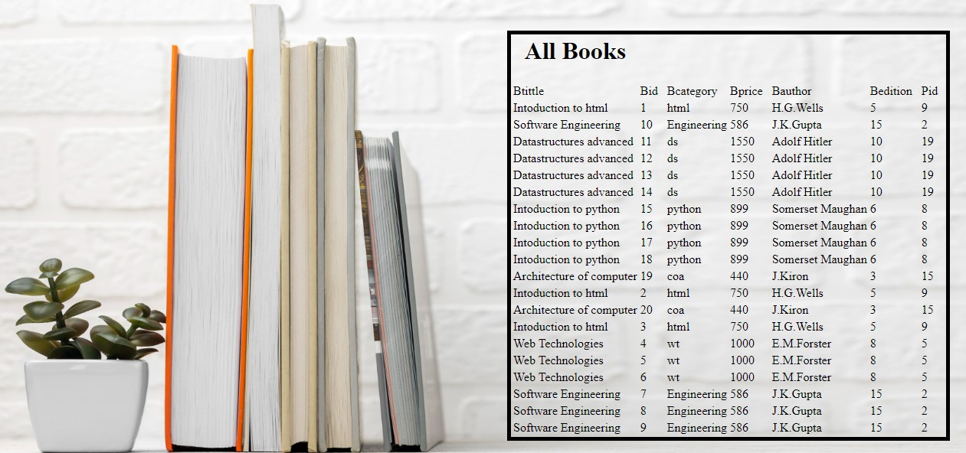
Available books

Slide 15
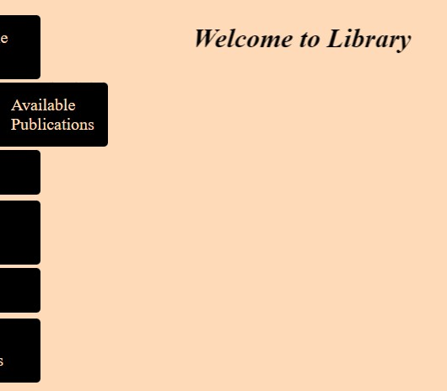

Available publishers

Slide 16
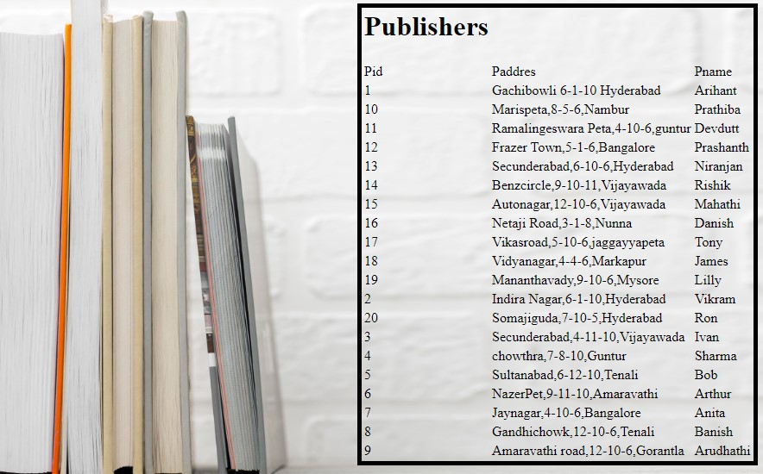
Available publishers

Slide 17
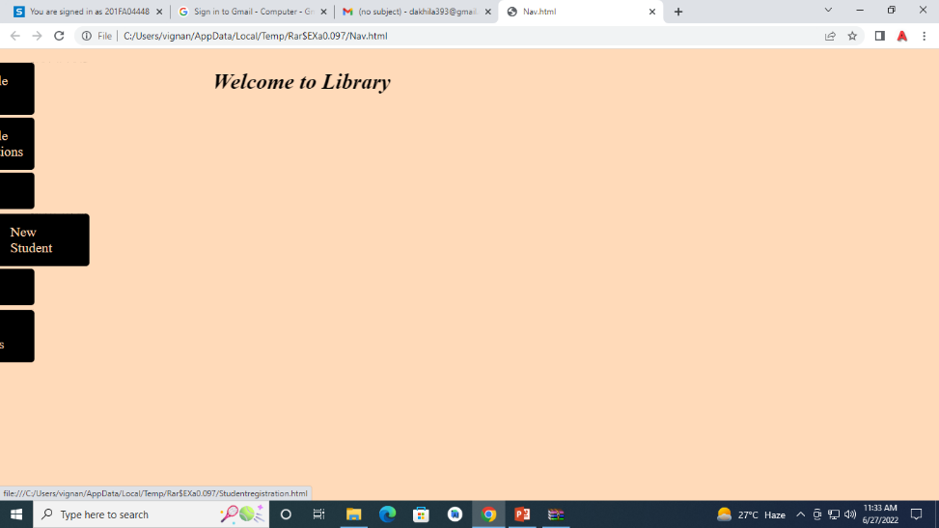
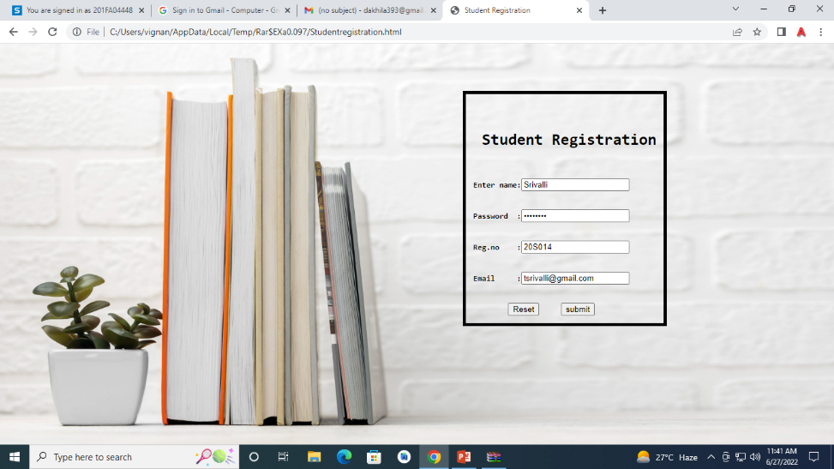
New Student

Slide 18
New Student
studentregistration
susername | Spassword | sreg | semail
Pravallika | Sony52 | 20S013 | kpravallika@gmail.com
Srivalli | Shannu65 | 20S014 | tsrivalli@gmail.com
Entered data will be stored in database

Slide 19
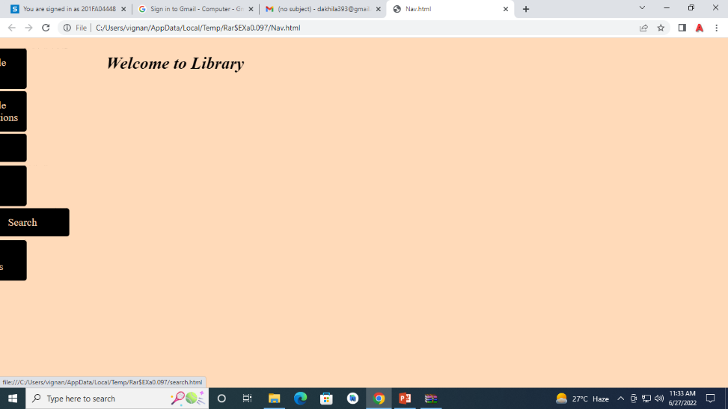
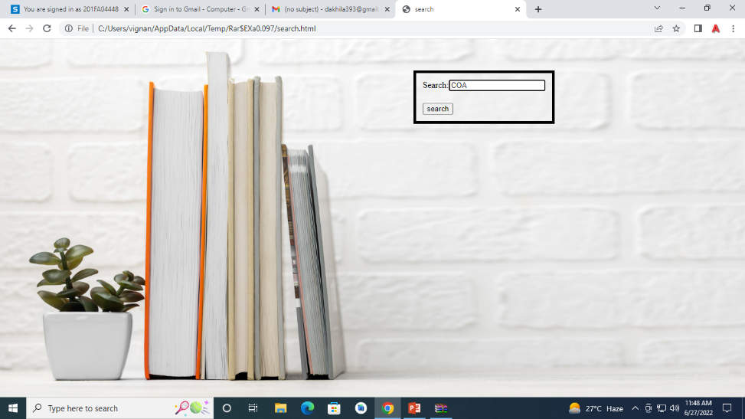
Search

Slide 20
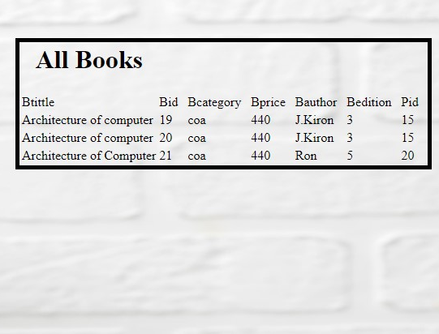
Search

Slide 21
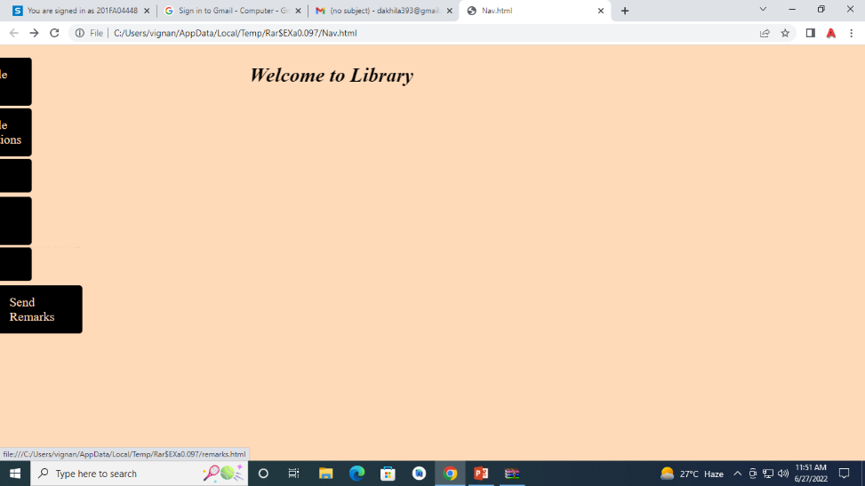
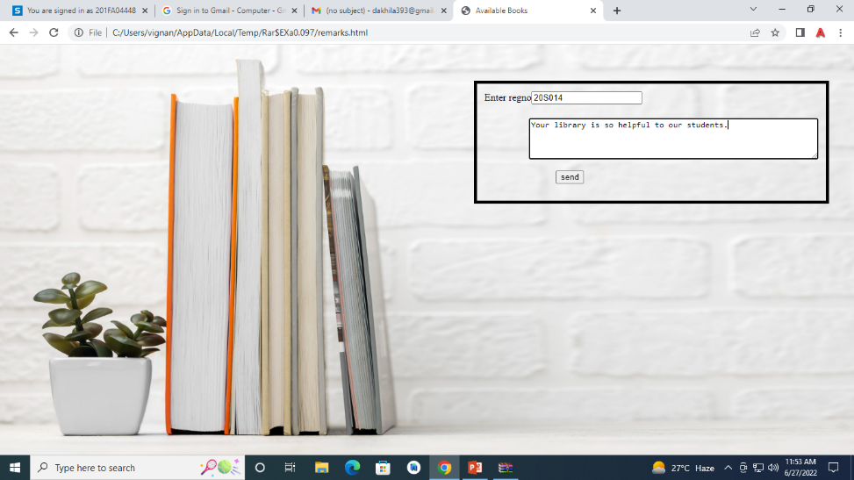
Send Remarks

Slide 22
Send Remarks
remarks
sreg | remarks
20S014 | your library is so helpful to our students.
Entered data will be stored in database

Slide 23
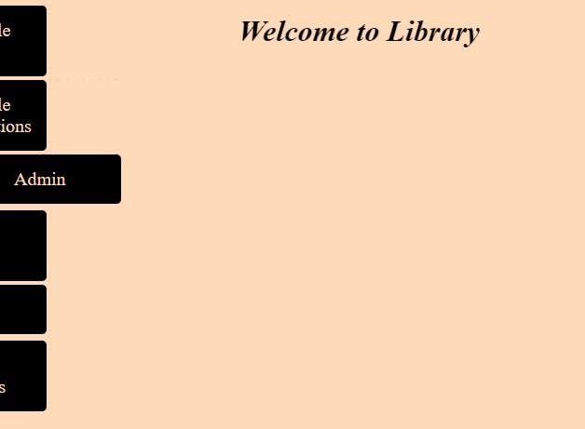
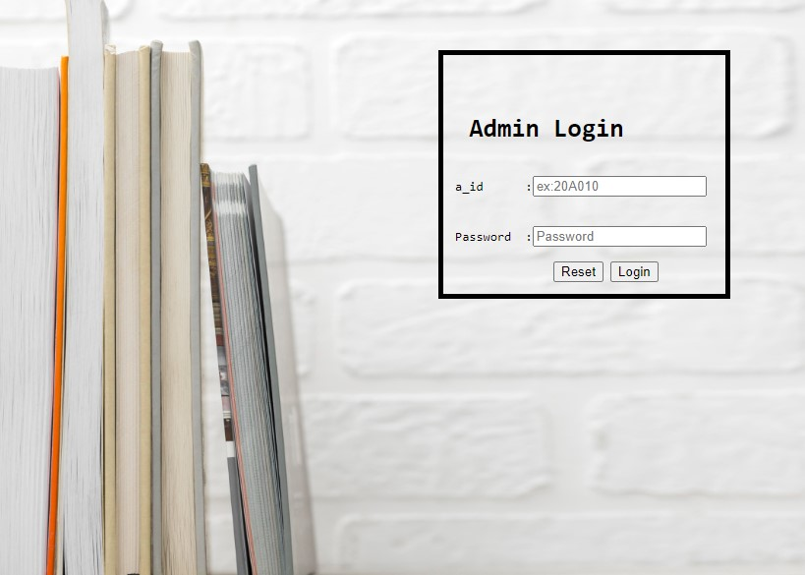
Admin Login

Slide 24
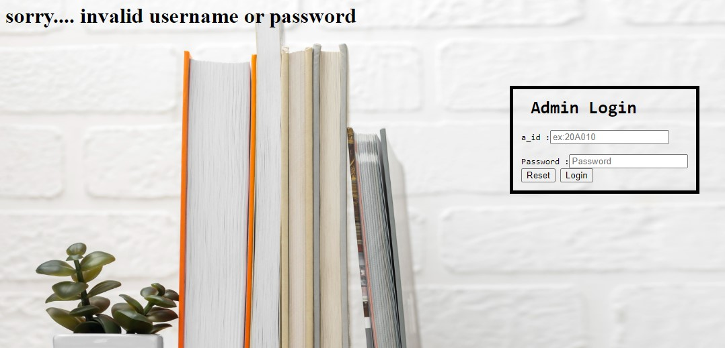
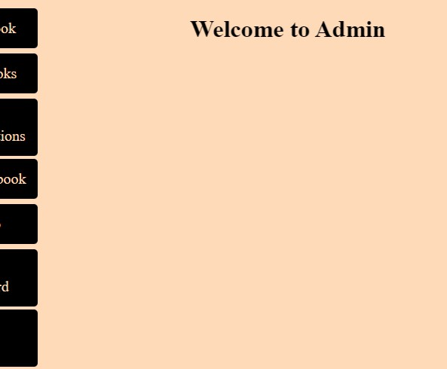
When correct credentials are entered ,admin page will be displayed.
When incorrect credentials are entered ,this will be displayed.

Slide 25

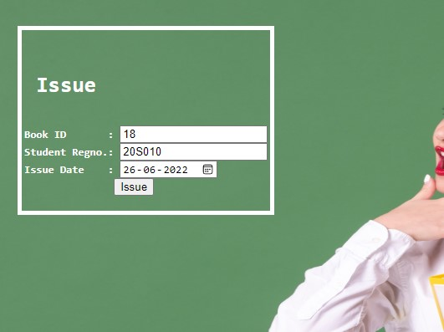
Issue Book

Slide 26
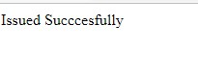
Issue Book
status
bid | sreg | issued
18 | 20S010 | 26-06-2022
Entered data will be stored in database

Slide 27
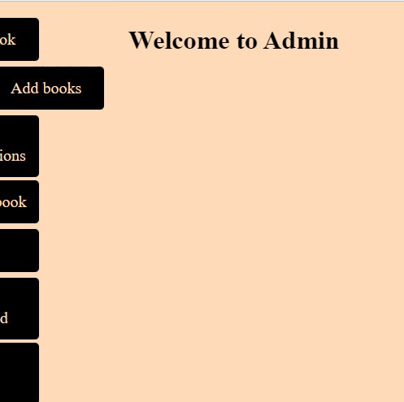
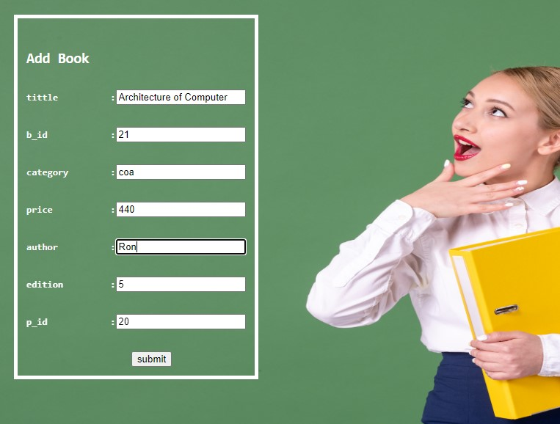
Add Book

Slide 28
Add Book
Entered data will be stored in database
book
btittle | bid | bcategory | bprice | bauthor | bedition | pid
Architecture of Computer | 21 | coa | 440 | Ron | 5 | 20

Slide 29
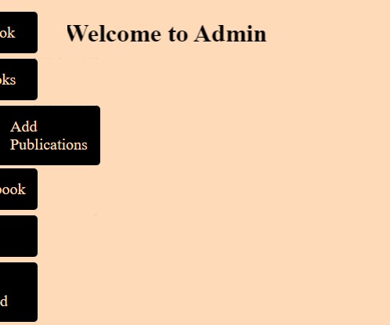
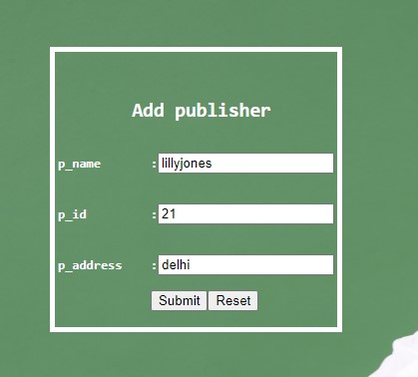
Add publisher

Slide 30
Add publisher
publisher
pid | paddress | pname
8 | Gandhichowk,12-10-6,Tenali | Banish
21 | delhi | lillyjones
Entered data will be stored in database

Slide 31
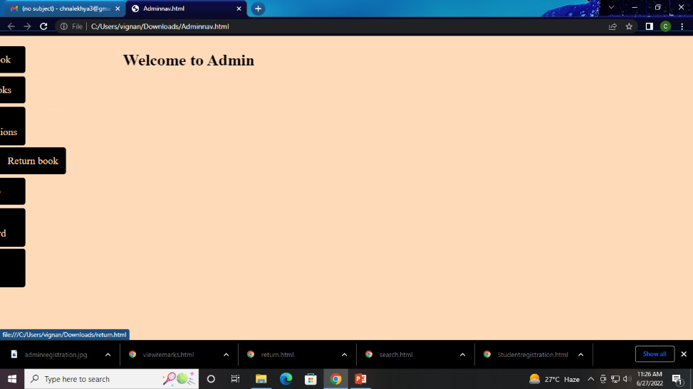
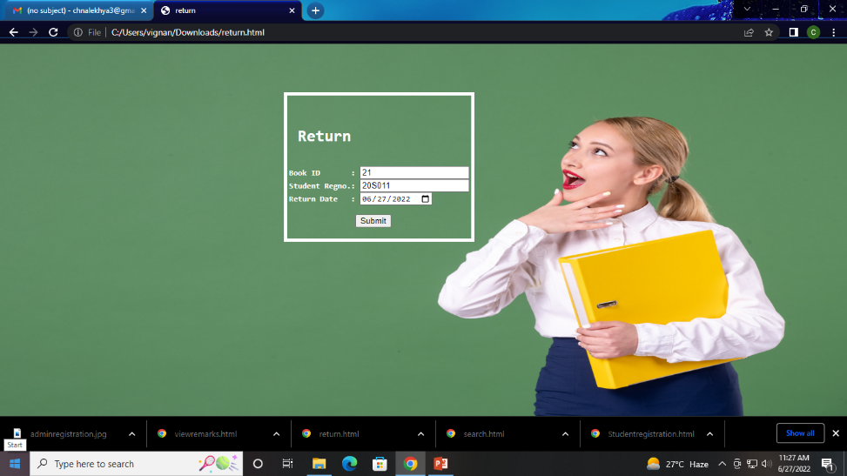
Return Book

Slide 32
Return Book
status
bid | sreg | issued
21 | 20S011 | 27-06-2022
Record related to the entered data will be deleted from database

Slide 33
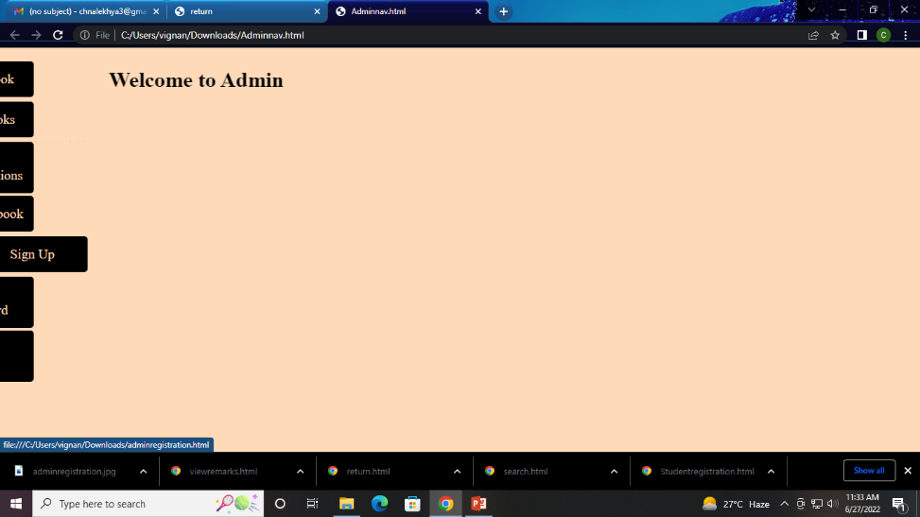
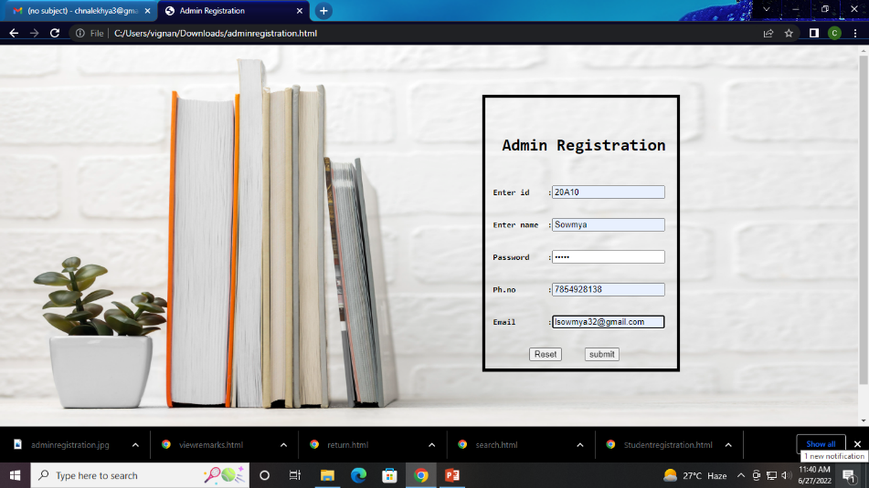
Admin Registration

Slide 34
Admin Registration
Entered data will be stored in database
adminregistration
ausername | apassword | aphone | aid | aemail
Sowmya | Sow10 | 7854928138 | 20A10 | lsowmya32@gmail.com

Slide 35
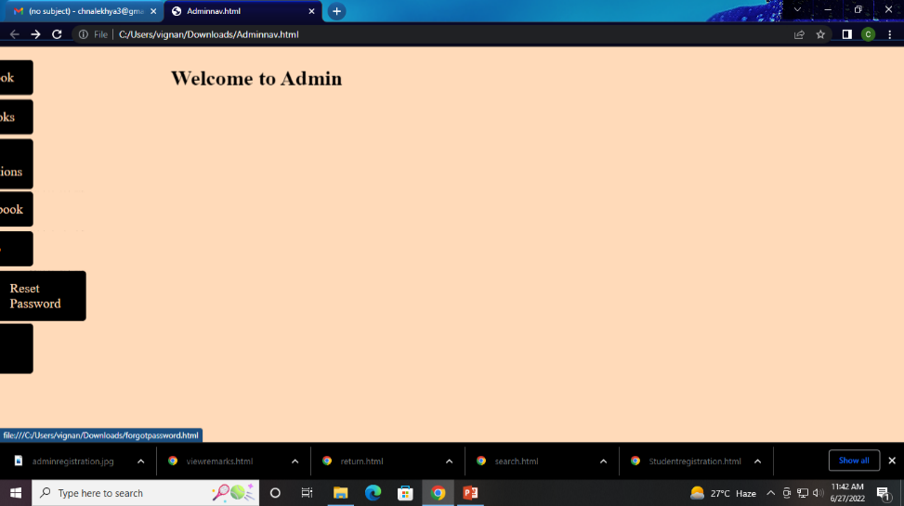
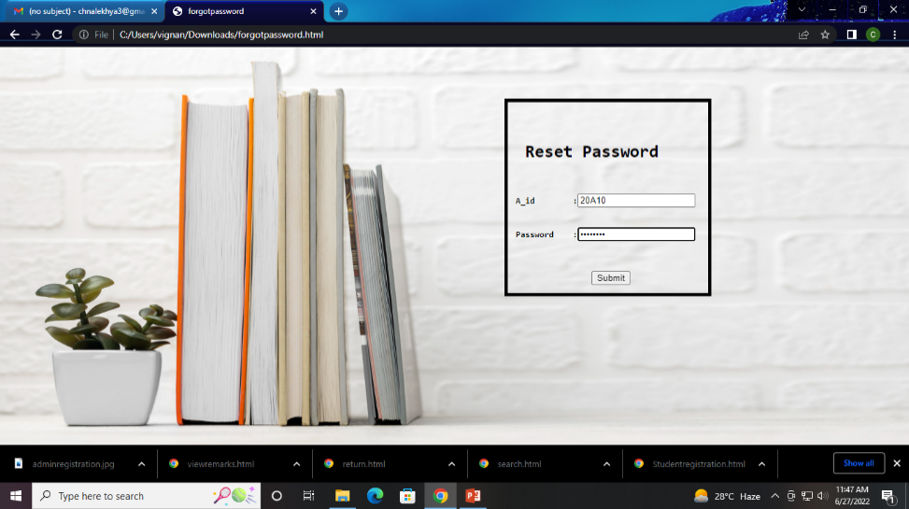
Reset Password

Slide 36
Reset Password
Password related to the entered data will be changed in database.
adminregistration
ausername | apassword | Aphone | aid | aemail
Sowmya | Sow10 | 7854928138 | 20A10 | lsowmya32@gmail.com

Slide 37
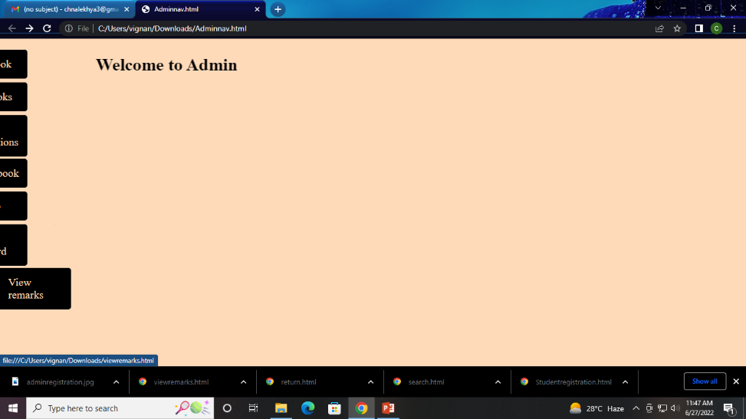
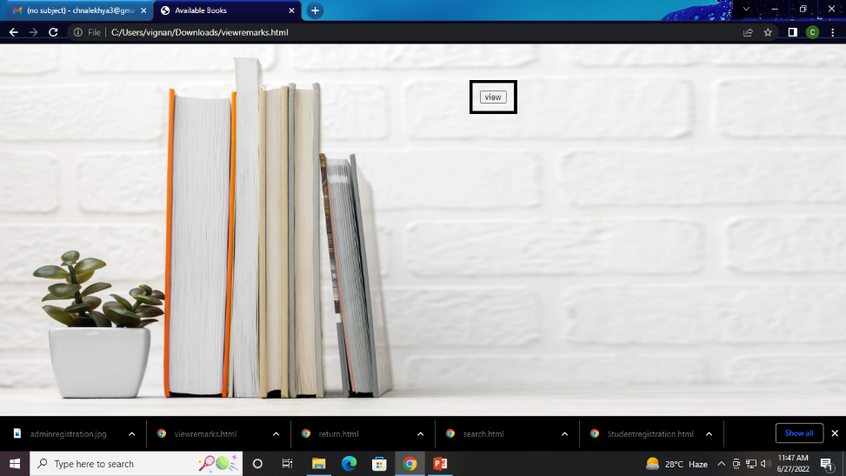
View Remarks

Slide 38
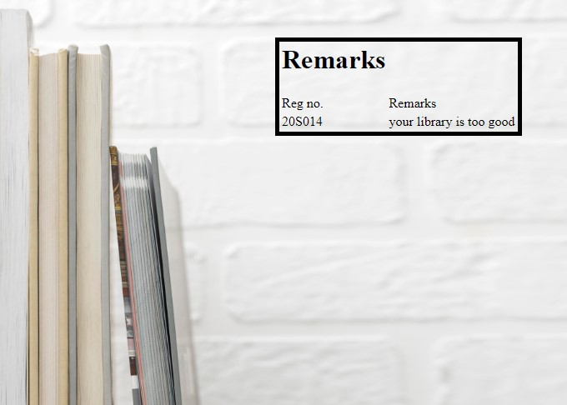
View Remarks

Slide 39
Conclusion
Library management system benefits the students as well as the staff of the library. Staff can search books, staff can generate reports and do book transactions. The implementation of this system will reduce data entry time and provide readily calculated reports.

Slide 40
THANK YOU

